Slide 1
Foreign Policy Archives Sergey Radchenko, Ph.D. Cardiff University, Wales

Slide 2
Overview
Federal archives
RGASPI (up to 1953) with exceptions
RGANI (1953-1980s) with exceptions
GARF (Soviet & post-Soviet)
Regional archives
Agency archives
TSAMO (Military)
AVPRF (Foreign Ministry)
SVR archives (Intelligence)
The key is to spread your activities widely because lack of access in one archive may be compensated by access elsewhere (e.g. cross-references between AVPRF & RGANI or RGANI and the regional archives)

Slide 3
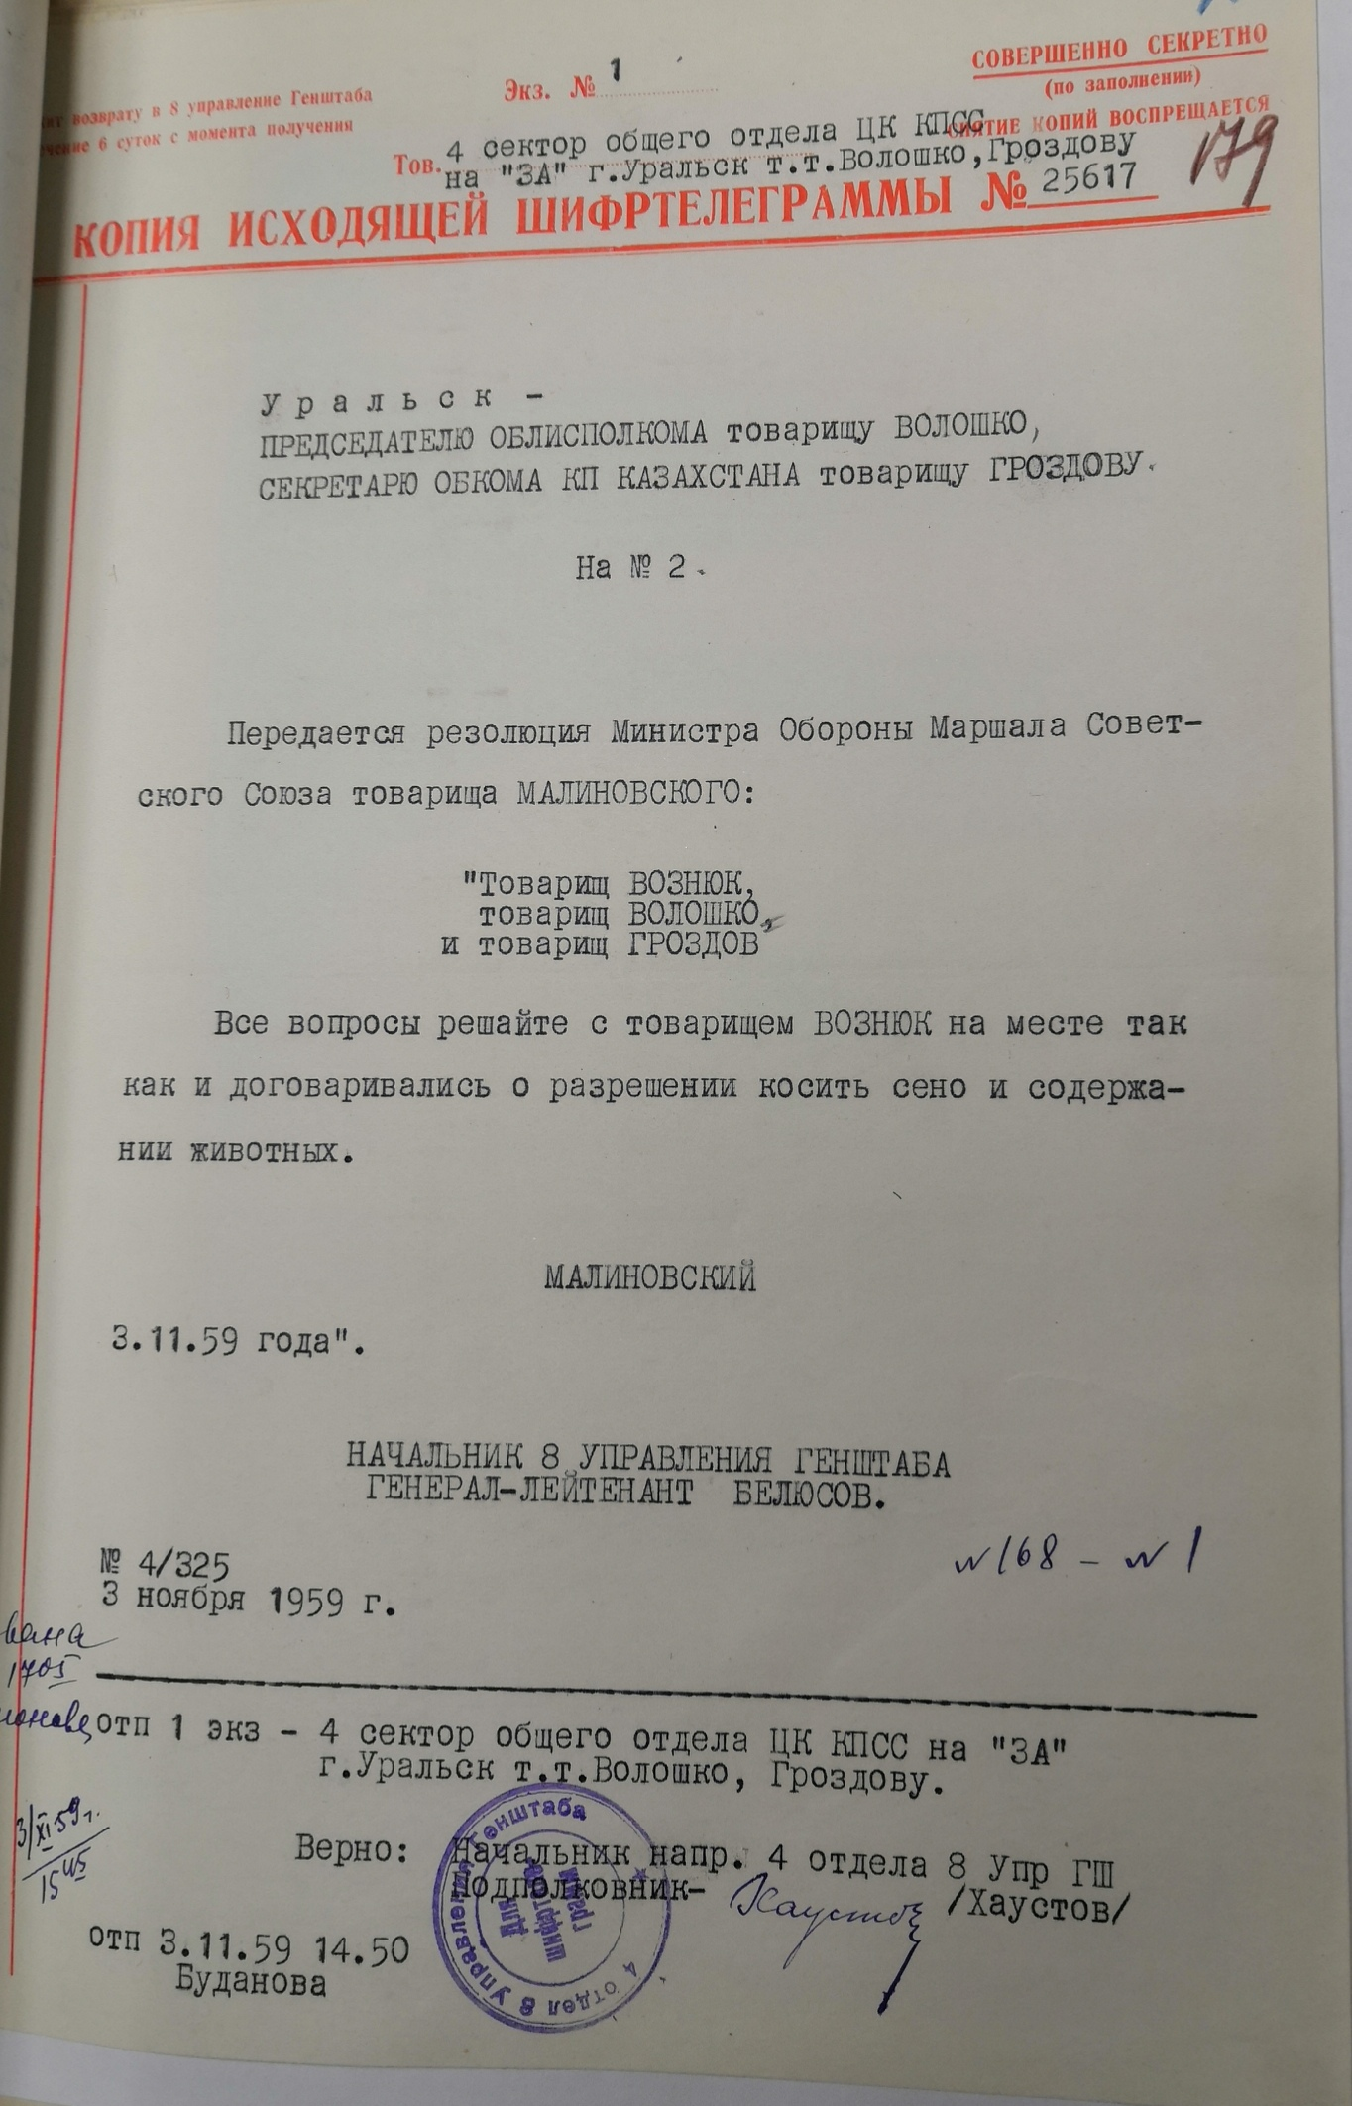
Broadly about access
Rules of research
Not uniform (different archive = different rules)
Make sure you have the right visa
Be prepared to leave enough time (from a minimum of two weeks at RGANI/RGASPI/GARF to a month or more at AVPRF)

Slide 4
AVPRF [Arkhiv Vneshnei Politiki Rossiikoi Federatsii]

Slide 5
The key place to visit for research on Russian foreign policy *but*
Takes a lot of time
Success is not guaranteed

Slide 6
Some general information about AVPRF
Located in Moscow, near the Foreign Ministry
There’s a Wikipedia page about it! (https://ru.wikipedia.org/wiki/Архив_внешней_политики_Российской_Федерации).
The key take-away from the page: the name of the director, Zaleeva Anna Nikolaevna

Slide 7
How to get in?
You’ll need to write a letter
The letter should be addressed to Anna Nikolaevna Zaleeva. I recommend writing it in Russian. Send your letter to avprf@mid.ru.
Then wait.
How long? Well, remember that your letter will go to a special MFA department for clearance, and the MFA will consult with the fond-keepers and the FSB. So… give it a month before calling.

Slide 8
The letter
What you put in the letter is very important, as it will govern your rules of access.

Slide 9
Before we get to the substance of the letter, let’s look at what’s AVAILABLE AT AVPRF
There’s no online finding aid (not for the entire collection anyway)
Material is arranged by so called “referenturas” (desks)
For example, there’s a Chinese referentura (100). This holds materials:
Of the Soviet Embassy in Beijing & various consulates
The China desk at the MFA (including records of meetings with Chinese diplomats in Moscow)
Materials that were originally classified are in 0100; those that were not (usually rubbish) are in 100.
Same pattern repeats for other referenturas, i.e. (0)129 (USA), (0)79 (Vietnam) and so on.
There is also a special referentura for the Minister of Foreign Affairs (06)

Slide 10
Practice
There is an online archive, run by the AVPRF, which hosts material for select referenturas for the 1941-45 period. The website is agk.mid.ru.
Check it out to get a sense of what these look like in practice.
Also, if your proposed topic is US-USSR relations in 1941-45 (or the Wartime Alliance or anything like this), you can just use the online archive, as if you request regular access, you won’t be able to get in.
You are now ready to write your letter but before you do, remember:
Access differs depending your chosen referentura. Some fond-keepers are nicer than others. Some will feed you rubbish; others will bring the real thing.

Slide 11
Letter pros and Cons
Breadth
If you letter is too broad (e.g. Soviet foreign policy, 1917-1991), you’ll be rejected. But if you are too narrow, you’ll be face constraints when ordering stuff at AVPRF
Chronology
A sensible chronology is something that doesn’t go beyond a couple of decades.
Be specific
Request access to specific referenturas *and* be sure to include the Minister’s referentura; you won’t automatically get access otherwise.

Slide 12
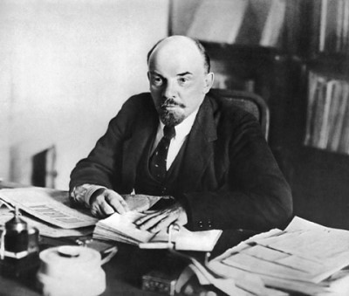
Example letter
Директору АВПРФ А.Н. Залеевой от Аспиранта Исландского Колледжа Песни и Пляски Гуннара Йорна Сталлоне
1-го января 2021 года
Уважаемая Анна Николаевна,
В связи с подготовкой монографии по теме «Советский Союз и Исландия, 1945-1965 гг», прошу предоставить мне доступ к соответствующим фондам АВПРФ, в том числе: к референтуре по Исландии, референтурам по Норвегии, Швеции, и Финляндии, к референтуре по международным организациям, и к референтуре министра иностранных дел СССР.
С уважением, Г.Й. Сталлоне

Slide 13
Сам Сингс ту Кип ин Майнд
You may not actually get all your preferred referenturas
For example, supposedly, they no longer give out the Minister’s referentura. Doesn’t hurt to ask!
Start calling after a month to agree on access
You’ll want to call the reading room (+7 499 241-51-12), and ask whether your propusk (pass) is ready.
Once it’s ready, you an come (bring your passport).
To save time, ask the reading room staff to order some documents for your in advance (will save you a week at least)

Slide 14
Rules in the reading room
Ordering
Equipment
Photocopies
You have to fill out a slip of paper. Be specific: “diary of the Soviet Ambassador to Iceland, 1964-65”. They might bring you something else. Keep at it, request it again.
Thankfully, you don’t have to type everything by hand. You can use your laptop (but not your camera). They are real difficult about people attempting to photograph stuff there, so I would not recommend you try. Learn how to type fast in Russian before heading there!
You’re out of luck. You can have 15-20 pages photocopied for the entire “subject” of your research. It’s free but it takes weeks (months?) You have to fill out a slip of paper to request photocopies. Do it if there’s someone who can pick them up for you or you plan to stay in Moscow for months

Slide 15
More rules in the reading room
Reading room staff
Fond-Keepeers
The process
These are your key allies. If you have good relations with them (never quarrel please!), they’ll accommodate you by arranging for more and better materials to be brought to you.
You won’t normally meet them but they are crucial to the success of your endeavour. It’s a hit and miss. Some fond-keepers are more open, some won’t give you anything.
The process of working at AVPRF is unlike that at any other archive. Here’s an approximate description →

Slide 16
The process
Order stuff
Read your order
Why am I given this?
You fill out little slips to order your materials. Depending on whether they are held in the building or off-site, it may take a week to get them. Use the time to explore other archives or just chill out in Moscow.
You’ll get maybe 5-10 dela. Read them. Pay attention to the classification (zero or no zero in front of the fond number). If there’s no zero, they’re feeding you junk. Why?
1) It could be that the materials you want are still classified. Declassification is uneven. Some materials have been declassified through the 1980s, others – not yet. Or maybe it’s the fond-keeper! Who knows!

Slide 17
The process part 2
persevere
Repeat
It’s getting better
Spend half a day reading your stuff even if you think it’s useless. Return it. Politely ask for what you originally requested.
Repeat a few times.
Joy! As you build trust with the reading room staff and the fond keeper (based on respect and tea – bring your own cookies), you’ll get better stuff. Some of it *really* good. Or maybe not. It’s just hit and miss. Don’t blame the staff. They are underpaid.

Slide 18
THANKS!
Any questions?
You can find me at @DrRadchenko or just e-mail me at RadchenkoS@Cardiff.ac.uk

