Slide 1
Peter Ruggenthaler Graz, Austria www.bik.ac.at “The Russian State Archives for Contemporary History” (RGANI) https://ргани.рф

Slide 2
Red Army in Austria 1945-1955
Stefan Karner – Barbara Stelzl-Marx, ed., The Red Army in Austria. Harvard Cold War Studies Book Series. (Lexington, Lanham et al., 2020)

Slide 4
Prague Spring 1968

Slide 5
Kennedy – Khrushchev Summit 1961 in Vienna

Slide 6
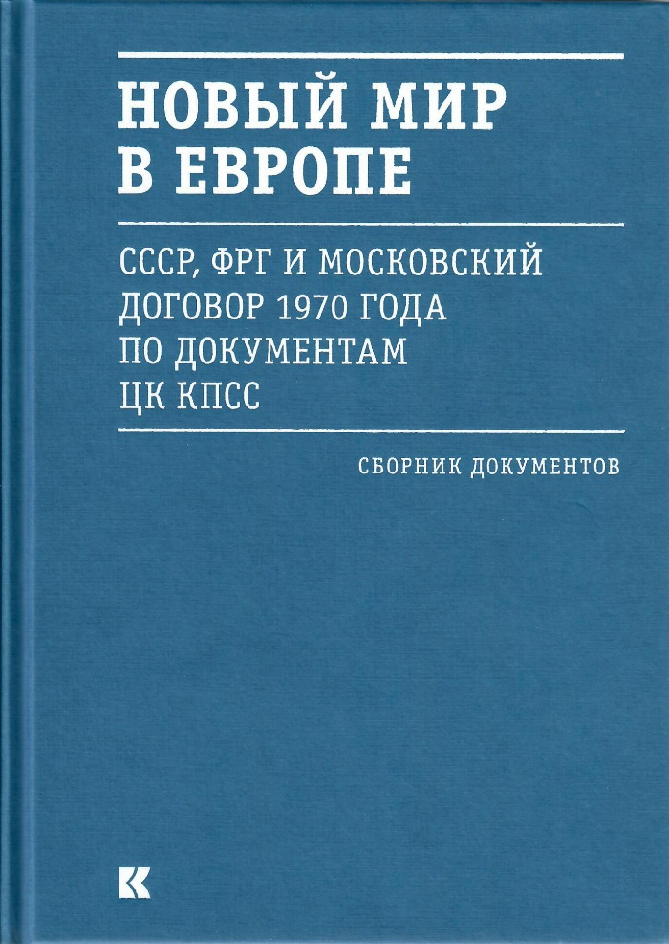
www.ostpolitik.de

Slide 7
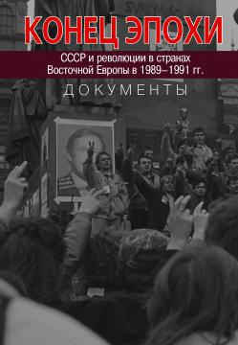
RGANI documents on 1989/90

